Slide 1
Chapter 16. Applying Patterns to Design a State Diagram Editor

Slide 2
Strategy Pattern

Slide 3
Intent
Define a family of algorithms, encapsulate each one, and make them interchangeable. Strategy lets the algorithm vary independently from clients that use it.
16-<number>

Slide 4
Also Known As
Policy
16-<number>

Slide 5
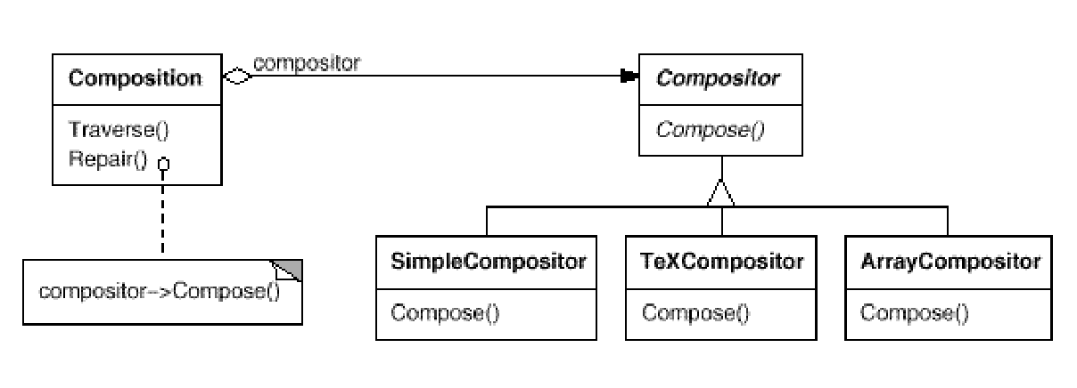
Motivation
A Composition maintains a reference to a Compositor object. Whenever a Composition reformats its text, it forwards this responsibility to its Compositor object.
The client of Composition specifies which Compositor should be used by installing the Compositor it desires into the Composition.
Without strategy, what will the code for breaking text into line look like?
16-<number>

Slide 6
Applicability
Use the Strategy pattern when
many related classes differ only in their behavior. Strategies provide a way to configure a class with one of many behaviors.
you need different variants of an algorithm. For example, you might define algorithms reflecting different space/time trade-offs.
an algorithm uses data that clients shouldn't know about. Use the Strategy pattern to avoid exposing complex, algorithm-specific data structures.
a class defines many behaviors, and these appear as multiple conditional statements in its operations. Instead of many conditionals, move related conditional branches into their own Strategy class.
16-<number>

Slide 7
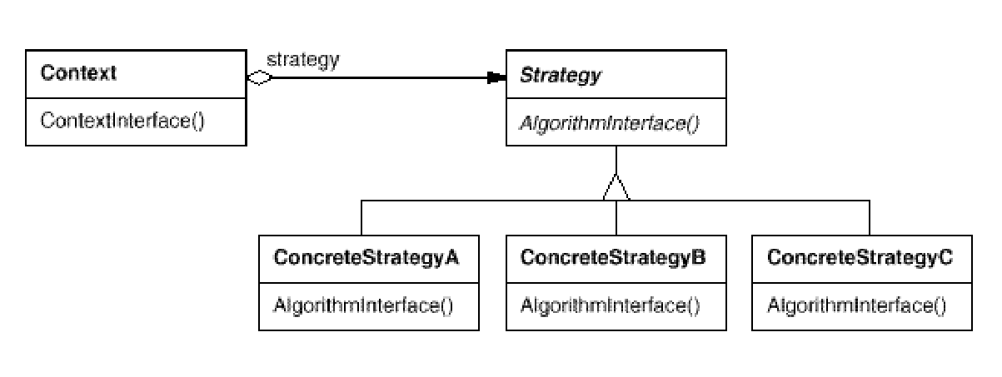
Structure
What is the communication overhead
between Strategy and Context?
16-<number>

Slide 8
Strategy (policy)
Client
Strategy
operation()
setContext(c: Context)
Context
getContextData(): Data
strategy
Strategy 1
operation()
Strategy 2
operation ()
Strategy 3
operation ()
16-<number>

Slide 9
Object Interaction in Strategy
client:
c:Context
s:Strategy K
K=1, 2, 3
create()
setContext(c)
process context, may get
data from context
operation()
d:=getContext():Data
16-<number>

Slide 10
Applying Strategy: The Mapping
Pattern:
Client
strategy
Strategy
operation()
setContext(c: Context)
Context
getContextData(): Data
context
Strategy 1
operation()
Strategy 2
operation ()
Strategy 3
operation ()
Editor design:
Edit Diagram Controller
State Diagram
draw(g: Graphics)
setLayoutAlgo(a: LayoutAlgo)
// other operations
<<Strategy>>
Layout Algorithm
layout()
setDiagram(d: State Diagram)
<<Strategy>>
Force-Based Layout
layout()
<<Strategy>>
Orthogonal Layout
layout()
<<Strategy>>
Hierarchical Layout
layout()
16-<number>

Slide 11
Applying Strategy
Edit Diagram Controller
The client calls setLayoutAlgo(a) to set selected algorithm, then calls draw (g).
State Diagram
draw(g: Graphics)
setLayoutAlgo(a: LayoutAlgo)
// other operations
layoutAlgo.layout();
for each c in components
c.draw(g);
diagram
layoutAlgo=a;
layoutAlgo. setDiagram(self);
layoutAlgo
<<Strategy>>
Layout Algorithm
layout()
setDiagram(d: State Diagram)
<<Strategy>>
Force-Based Layout
layout()
<<Strategy>>
Orthogonal Layout
layout()
<<Strategy>>
Hierarchical Layout
layout()
16-<number>

Slide 12
Object Interaction in Editor Strategy
:Edit Diagram Controller
:State Diagram
a :Layout Algorithm
beautify()
setLayoutAlgo(a)
setDiagram(self)
draw(g)
layout()
for each c in components
c.draw(g);
16-<number>

Slide 13
Benefits and Liabilities of Strategy
Benefits
  Eliminate conditional statements – reducing complexity.
  Let the client select the algorithm – changing the behavior of the subject dynamically.
  Allow different algorithms to apply to the same data structure – hiding the data structure from the subject.
Liabilities
  The client must know the strategies and how to choose them.
  Breaking encapsulation – the strategies may need to know the data structure of the subject.
  Communication overhead between Strategy and Context.
16-<number>

Slide 14
Application
Consider how strategy can be applied in the following situations:
  networks routing
  circuit layout
  work scheduling
  work flow management
  discount policy
  printing a document
16-<number>

Slide 15
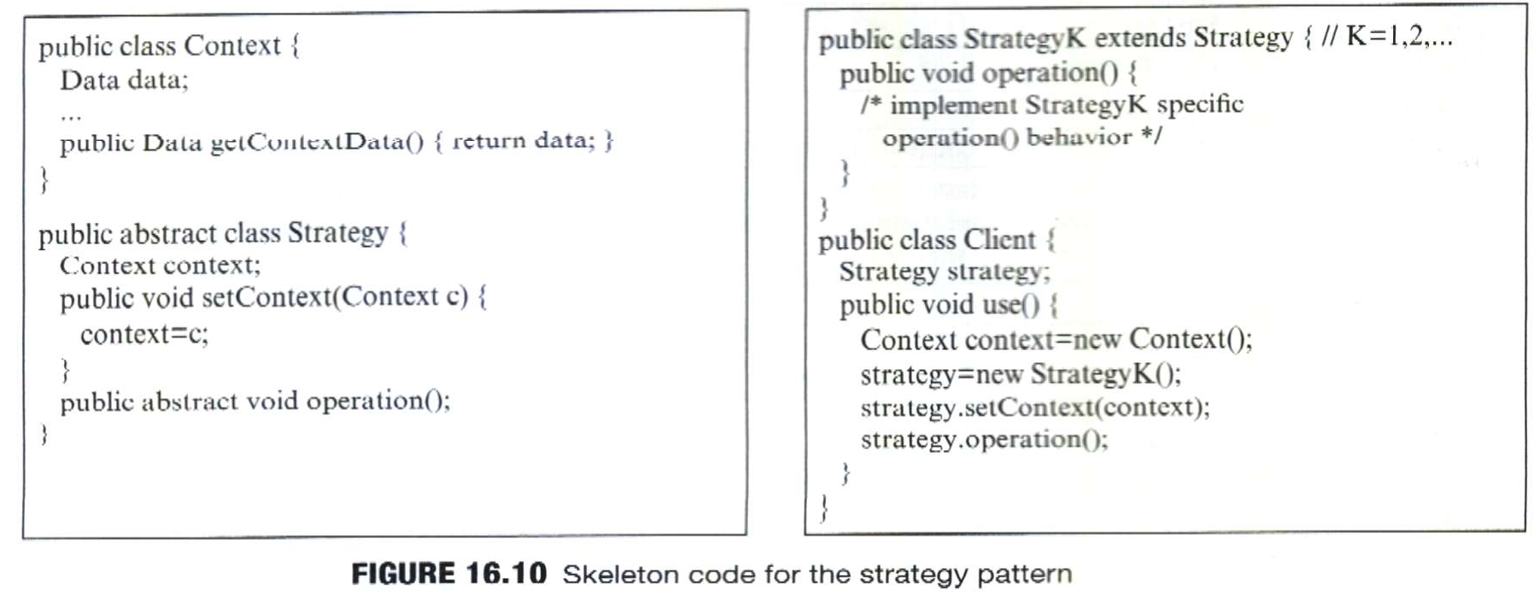
16-<number>

Slide 16
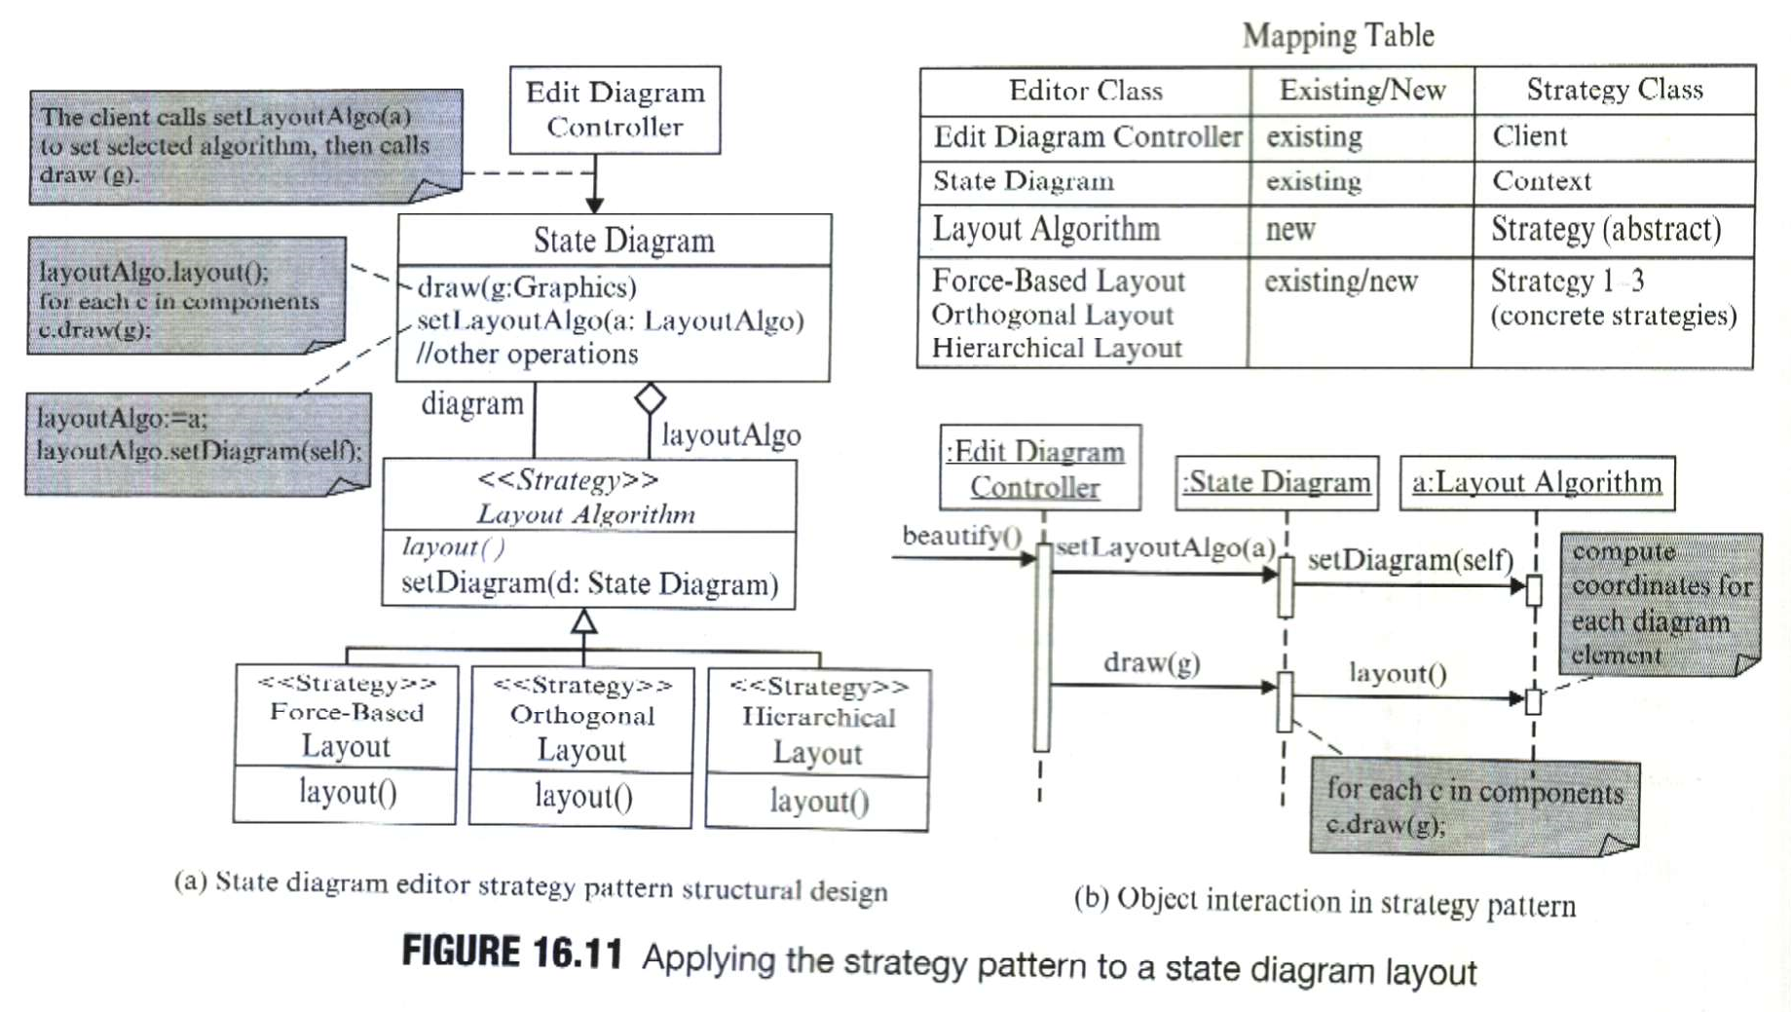
16-<number>

